Slide 1

Introduction to Single Cell Technologies Adrien Osakwe Yasmin Jolasun Experimental Medicine MSc Student Dr. Jun Ding

Slide 2
Workshop Agenda
Intro to Single Cell Sequencing
What is single cell sequencing?
Uses of single cell technology
Overview different single cell protocols
BREAK
Demonstration and Application of Single Cell data Processing
Introduction to cell ranger
Introduction to Scanpy analysis (hands on)

Slide 3
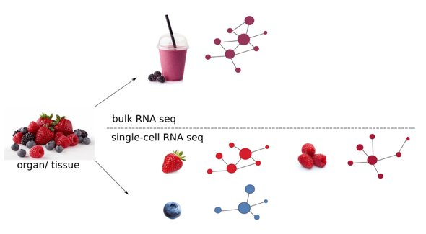
What is single cell sequencing?
"Single-cell sequencing technologies refer to the sequencing of a single-cell genome or transcriptome, so as to obtain genomic, transcriptome or other multi-omics information to reveal cell population differences and cellular evolutionary relationships." Tang, X., Huang, Y., Lei, J. et al. Cell Biosci
•Have information for individual cells​
•Can get information for small cell populations
Notes:
measure gene expression levels at the resolution of single cells
you get an averaged gene expression profile of all the cells in the sample. Continuing the fruit analogy, bulk RNA-Seq could be viewed as a smoothie, where you sample a mixture of blended fruits which gives you an average signal of all cells in the sample.

Slide 4
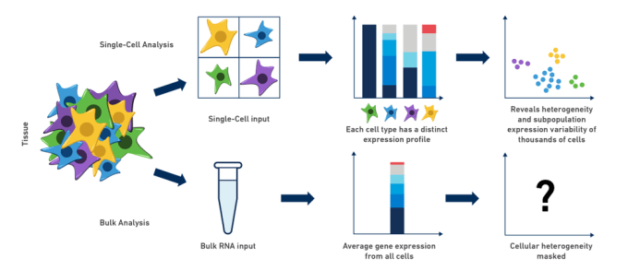
Pros and Cons of Single Cell Sequencing
Cons
Expensive (read depth, number of cells and samples)
A lot of noise (Sparsity)
Large files
Pros
Heterogenity
Novel cell type discovery
High resolution

Slide 5
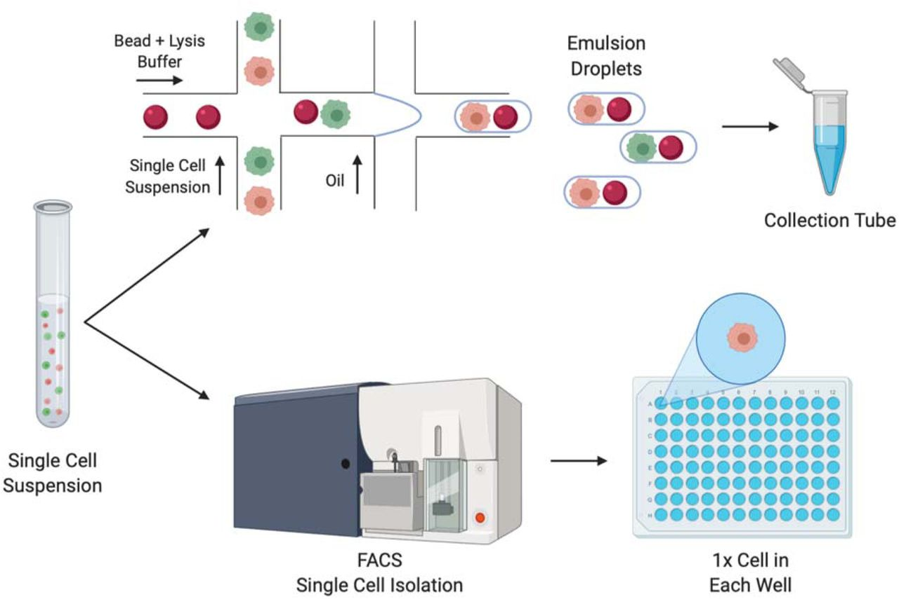
Single Cell Methods

Slide 6
Single Cell Methods
Plated Based (SMART seq2)
Plate-based – lower throughput and more expensive
Full read design – More reliable gene detection and can assess splicing
Data is less noisy
Droplet Based (10x genomics)
Droplet-based – High throughput for cheap
UMI (Unique Molecular Identifier) – Can Multiplex cells and samples
High dropout rate

Slide 7
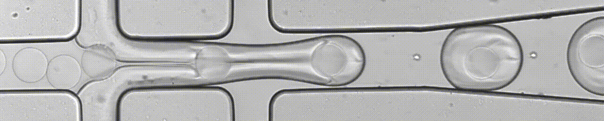
Single Cell Methods

Slide 8
BREAK (10-15 mins)

Slide 9
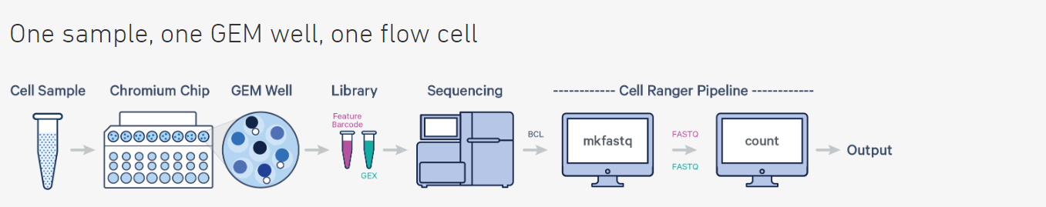
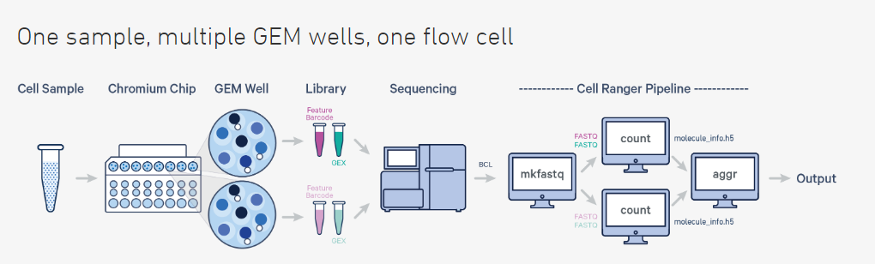
10X GENOMICS PIPELINE - CellRanger

Slide 10
Hands On
Head to this page: GitHub - ksmcu/MicM_intro_singlecell to follow the tutorial

Slide 11
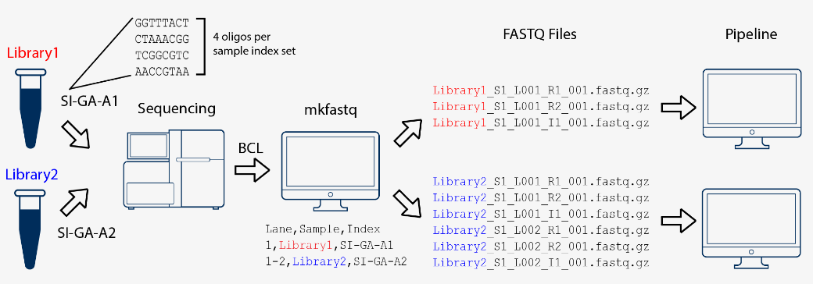
cellranger mkfastq
•Input:
•BCL files
•CSV file containing Sample ID, Flow cell lane and Index used
•Output:
•Report files
•2 to 3 fastq files (one for each read, one for the index)

Slide 12
cellranger count
Input (Required):
Path to fastq files
Run ID
Sample name (based on fastq file names)
Reference Transcriptome
Output:
Summary Report
Barcodes, Features and Count Matrix (HDF5 file)

Slide 13
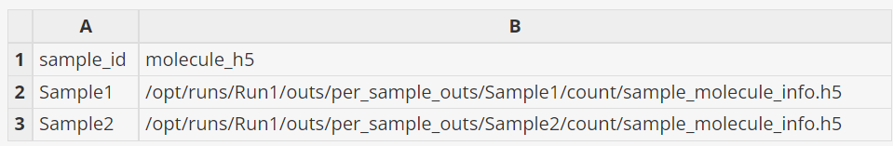
cellranger aggr
Input (Required):
CSV file with two columns (Column 1 – Sample ID, Column 2 – Path to molecule_info.h5 file)
Output:
Same as cellranger count outputs

Slide 14
Scanpy analysis

Slide 15
Thank you and Feedback!

